Slide 1
Employee Data Analysis using Excel
STUDENT NAME:E.MAHESWARI
REGISTER NO:2213391042033 , 231126F041C21178F29492B5E334C1A
DEPARTMENT:BACHELOR OF COMMERCE{CORPORATE SECRETARYSHIP}
COLLEGE:QUEEN MARY’S COLLEGE

Slide 2
PROJECT TITLE
Employee Salary Dataset
using Excel

Slide 3


AGENDA
Problem Statement
Project Overview
End Users
Our Solution and Proposition
Dataset Description
Modelling Approach
Results and Discussion
Conclusion
3/21/2024 Annual Review

Slide 4

PROBLEM STATEMENT
1. Salary Disparities: Significant salary differences exist across departments and companies.
2. Departmental Imbalance: Certain departments (e.g., Search Engine) have much higher salaries than others (e.g., Support).
3. Company-wise Variations: Salary ranges vary widely across companies (e.g., Cheerper, Glasses, Pear).
4. Lack of Standardization: No standardized salary structure is evident, leading to potential inequities.
5. Need for Analysis: In-depth analysis is required to understand the root causes of these disparities and develop strategies for fair compensation and talent retention.

Slide 5

PROJECT OVERVIEW
1. Salary Analysis: Analyze salary data across departments and companies to identify trends and disparities.
2. Departmental Comparison: Compare salaries across Design, Sales, Search Engine, and Support departments to identify variations.
3. Company-wise Analysis: Examine salary data for Cheerper, Glasses, and Pear companies to identify differences and similarities.
4. Data Visualization: Use pivot tables and graphs to visualize the data and facilitate understanding of complex salary trends.
5. Insights and Recommendations: Provide actionable insights and recommendations to address salary disparities and inform fair compensation strategies.

Slide 6

WHO ARE THE END USERS?
1. HR Managers: To analyze salary data, identify trends, and make informed decisions about compensation and benefits.
2. Department Heads: To compare salaries across departments, identify disparities, and optimize team compensation.
3. Compensation Analysts: To analyze salary data, identify trends, and develop fair and competitive compensation packages.
4. Business Leaders: To understand salary trends, make strategic decisions, and allocate resources effectively.
5. Data Analysts: To analyze and visualize salary data, identify insights, and provide recommendations to stakeholders.

Slide 7

OUR SOLUTION AND ITS VALUE PROPOSITION
1. Comprehensive Salary Analysis: Our solution provides a detailed analysis of salary data across departments, companies, and roles.
2. Data-Driven Insights: Our solution offers actionable insights and recommendations to address salary disparities, optimize compensation, and improve talent retention.
3. Customizable Visualizations: Our solution provides interactive and customizable visualizations to facilitate understanding and exploration of complex salary data.
4. Strategic Decision Support: Our solution enables business leaders to make informed decisions about compensation, resource allocation, and talent management.
5. Enhanced Transparency and Fairness: Our solution promotes transparency and fairness in compensation practices, leading to increased employee satisfaction and reduced turnover

Slide 8
Dataset Description
1. Salary Data: The data represents salary information for employees across different departments and companies.
2. Departmental Breakdown: Salaries are categorized by department: Design, Sales, Search Engine, and Support.
3. Company-wise Data: Salary data is provided for three companies: Cheerper, Glasses, and Pear.
4. Aggregate Values: Grand totals are displayed for each department, company, and overall salary.
5. Numerical Values: Salary values are represented in numerical format, allowing for easy analysis and comparison.

Slide 9
MODELLING
1. Relational Modeling: Salary data is modeled relationally, connecting departments, companies, and salaries.
2. Hierarchical Modeling: Departmental and company-wise hierarchies are established to facilitate drill-down analysis.
3. Aggregation Modeling: Salary values are aggregated to provide grand totals and subtotals.
4. Dimensional Modeling: Dimensions (departments, companies) are created to enable slicing and dicing of salary data.
5. Analytical Modeling: Analytical models (e.g., ratios, percentages) can be applied to identify trends and insights.
‹#›

Slide 10
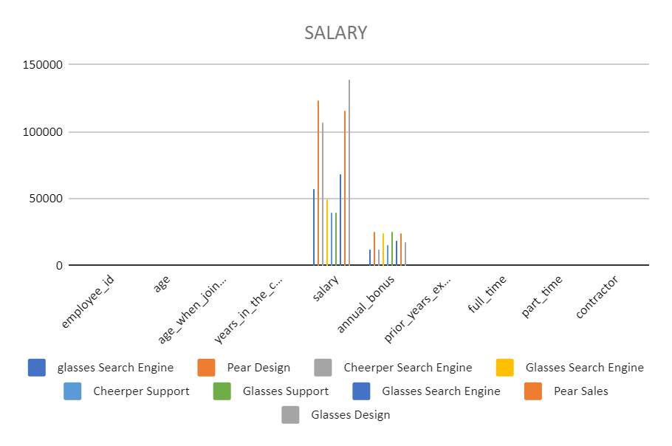
RESULTS
Sum of salary | department
company | Design | Sales | Search Engine | Support | Grand Total
Cheerper |  |  | 106540.1545 | 40000 | 146540.1545
glasses | 138211.8841 |  | 174394.6681 | 40000 | 352606.5522
Pear | 123662.8408 | 115645.6338 |  |  | 239308.4746
Grand Total | 261874.7249 | 115645.6338 | 280934.8226 | 80000 | 738455.1813
‹#›

Slide 11
conclusion
The analysis of the salary data reveals significant insights into the compensation structure across departments and companies. Key findings include:
- Design and Search Engine departments have the highest average salaries.
- Glasses company has the highest total salary, followed closely by Pear.
- Support department has the lowest average salary across all companies.
- There is a notable disparity in salaries between departments and companies, indicating potential areas for review and adjustment.
Overall, this analysis provides a comprehensive understanding of the salary landscape, enabling informed decisions about compensation, talent management, and resource allocation.

